Slide 1

Secure access to dataset of sound files: Encr/decr by LEA in CFB mode + secret key delivery with RSA + Schnorr signature
By :
Basel Haddad
Tamer Talhami
Mohamad Dukhi
Waseem Saleem

Slide 2




Sound File Overview
Sound File Characteristics:
Why Different from Regular Files?
* Structured format with headers, metadata, and sound data
*Encryption must preserve structure for playback functionality.
* Regular files are generic binary streams, while sound files have strict format requirements.
* Playback functionality depends on preserving headers and metadata.

Slide 3


LEA Encryption
Developed by KISA (Korea Internet & Security Agency) in South Korea.
Uses 128/192/256-bit keys with a fixed 128-bit block size.
An ARX-based (Addition-Rotation-XOR) lightweight cipher:
  optimized for both software and hardware implementations.
  operates efficiently with low memory and processing power.
designed to be:
  lightweight and efficient for resource-constrained devices.
  secure against modern cryptographic attacks.
  fast with high throughput for real-time encryption.

Slide 4
Key Expansion
Purpose: To generate a unique round key for each encryption round.
Steps:
  Input: Master key (128, 192, or 256 bits).
  The master key is split into multiple 32-bit words. (e.g 128-bit key: 4 words.).
  Round Constants:
    A predefined sequence of constants is used for each round. These constants ensure that round keys vary significantly and cannot be easily predicted
    Constants are added during key expansion to prevent symmetry in encryption.
  Key Transformation Operations: For each round key, the following steps are applied:
    Modular Addition (+mod 2^32)
    Bitwise Rotation (Left or Right):
  A series of round keys, each consisting of 192 bits (6 subkeys of 32 bits each). A total of 24 round keys are generated for 24 rounds in LEA-128.

Slide 5
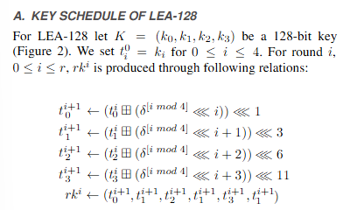
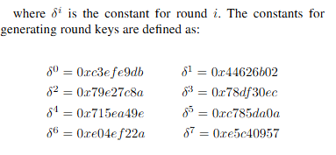
Key Expansion Process

Slide 6
LEA Round Cipher Process
Overview of Rounds:
  LEA performs 24 rounds for a 128-bit key (more for larger keys).
  Each round processes the 128-bit input block by splitting it into four 32-bit words and applying transformations.
Input Structure:
  The input block (plaintext) X is divided into four 32-bit words: X0, X1, X2,X3
  Each word is transformed during the round using the corresponding round key and cryptographic operations.
Operations Per Round: Each round applies the following three steps:
  Modular Addition ( + mod 2^32):
Adds the first word (X0​) with the corresponding part of the round key (RK1).
Bitwise Rotation:
Rotates the result of the addition by a predefined number of bits (e.g., 3, 5, or 7 bits).
XOR Operation:
Applies an XOR operation to mix the data across words, enhancing diffusion.
Output of Each Round:
  The transformed words become the input for the next round.
  After the 24th round, the final 128-bit block is the ciphertext.

Slide 7
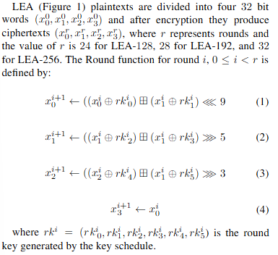
LEA Round Cipher Process

Slide 8
LEA Encryption in CFB Mode
Encrypt the Feedback Block (128 bits):
Encrypt the IV or feedback block with LEA to produce Ki (128 bits).
K0=LEA (IV) , Ki = LEA (IV(i-1))
Extract the Keystream (First S-Bits):
  Take the first S-bits from the left (MSB) of Ki:
  Ki_s = Ki [ 0 : s]
Use the Keystream for XOR with Plaintext:
  XOR the S-bit plaintext chunk (Pi​) with Ki_s​:
  Ci = Pi (Xor) Ki_s
Update the Feedback (IV):
  Form the new IV by shifting the remaining bits and appending Ci:
  New IV = (S-right bits in IV || Ci)

Slide 9
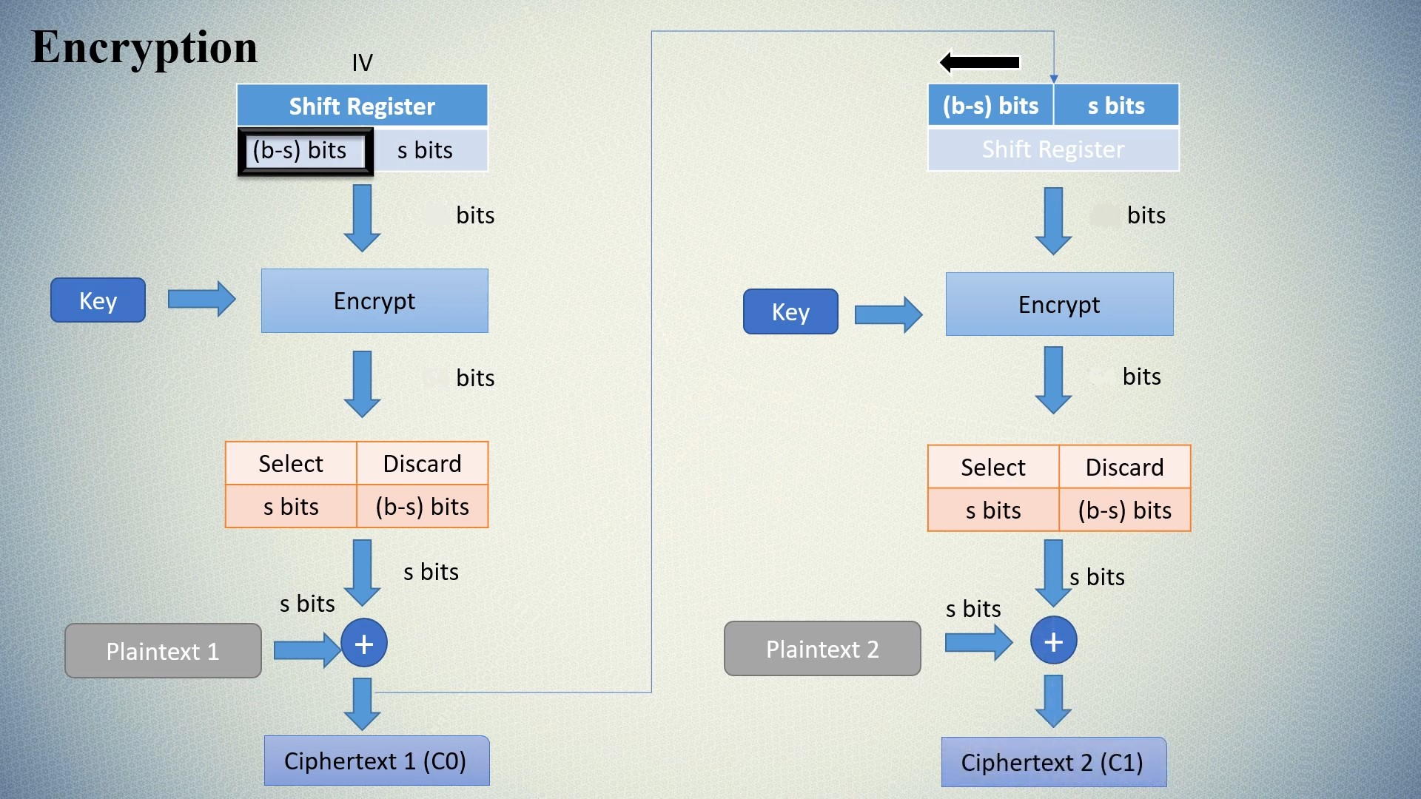



Encryption in CFB Mode Diagram
X0
X1
128
128
128
128

Slide 10
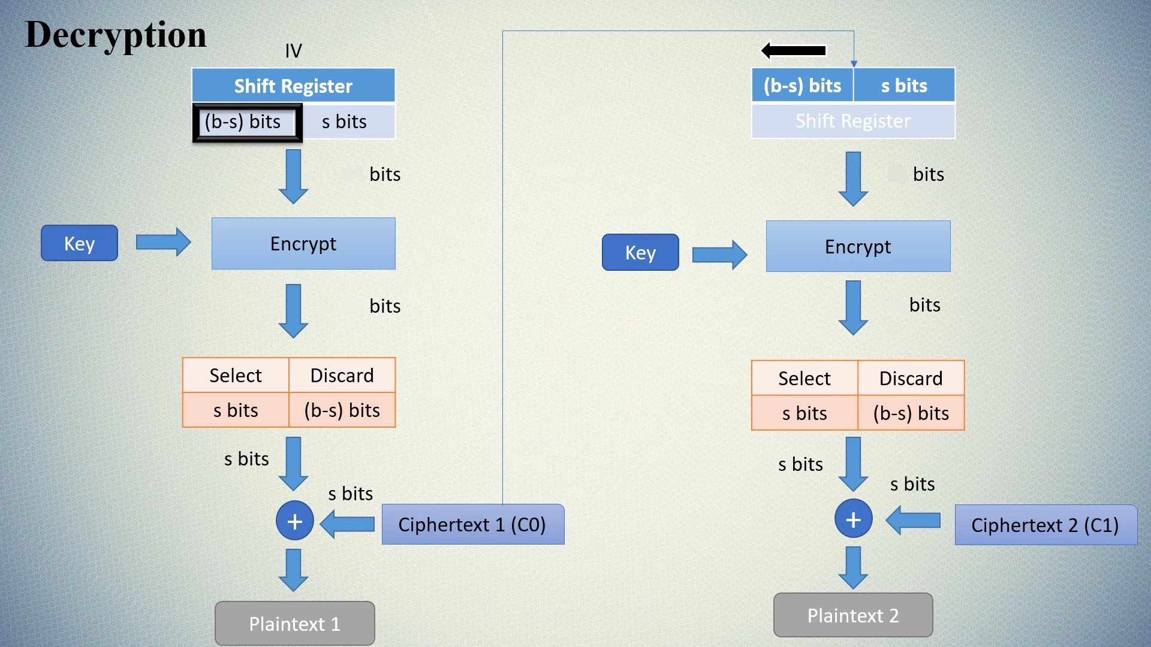



Decryption in CFB Mode Diagram
X0
X1
128
128
128
128

Slide 11
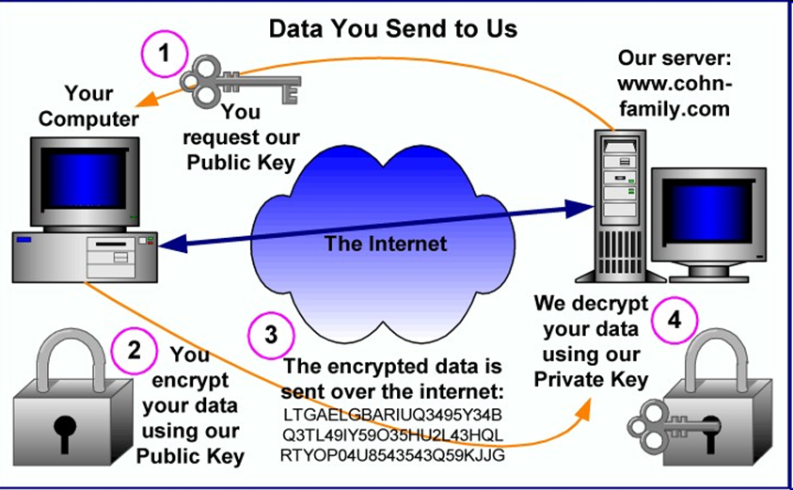
Introduction to RSA
Developed in 1977 by Rivest, Shamir, and Adleman (RSA).
First practical public-key cryptosystem based on the difficulty of factoring large integers.
Uses asymmetric keys:
- Public key for encryption (shared).
- Private key for decryption (kept secret).
Widely used for secure communication, digital signatures, and key delivery.

Slide 12

RSA Key Generation
1. Generate two large random prime numbers, p and q.
2. Compute the modulus, n = p × q.
3. Calculate Euler’s totient function, φ(n) = (p-1)(q-1).
4. Determine e where 1<e<φ(n) and gcd(e,φ(n))=1
5. Determine private key, d, such that (e × d) ≡ 1 mod φ(n).
6. Publish the Public Key: (e, n).
7. Keep the Private Key secret: (d, p, q ).

Slide 13

RSA Encryption and Decryption
Encryption:
- Ciphertext (C) = Plaintext^e mod n.
- Sender uses the recipient's public key (e, n).
Decryption:
- Plaintext (M) = Ciphertext^d mod n.
- Recipient uses their private key (d, n).
RSA ensures confidentiality, as only the private key can decrypt.

Slide 14
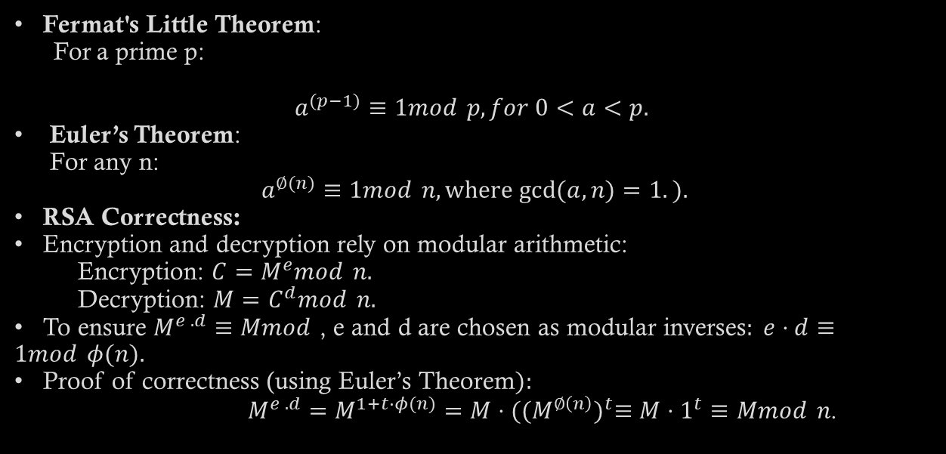
RSA Math Background

Slide 15
Why RSA for Key Delivery?
1. Security: RSA's security stems from the computational difficulty of factoring 𝑛=𝑝⋅𝑞 into its prime components, which becomes infeasible as 𝑛 grows large.
2. Asymmetry: Only the private key holder can decrypt the key (Many can encrypt but one can decrypt.
3. Compatibility:
-Easily integrates with the LEA encryption process
-Computation of gcd⁡(𝑎,𝑛) and modular exponentiation is efficient (𝑂(log⁡𝑛).
- RSA Adds an additional layer of security to the project.

Slide 16
RSA in the Project
· Key Generation:
2048-bit RSA keys are generated for strong security.
Public exponent: e = 65537.
· Encryption:
The LEA key (128 bits) is encrypted using RSA.
Ensures confidentiality during transmission.
· Decryption:
RSA private key decrypts the LEA key for use in CFB mode encryption.
· Usage in the Project:
Used for secure delivery of the symmetric LEA key.
Sender encrypts the LEA key using the receiver's public key.
Receiver decrypts the LEA key using their private key.
Ensures only the intended recipient can access the LEA key.
Integrates with LEA encryption and Schnorr signature for a complete secure workflow.

Slide 17
Schnorr Signature
Part of Secure Access to Sound Files

Slide 18
How Schnorr Signature Works
Signing
Components:
A random nonce (r) is being generated to calculate a commitment. The message (m), public key (p), and commitment (R) are hashed to produce a challenge (c). Finally, the signature is created using the private key, nonce, and challenge. The output is the commitment & signature.
Private key x
Public key p
Random nonce r
Generator random G
Commitment R
Challenge c

Slide 19
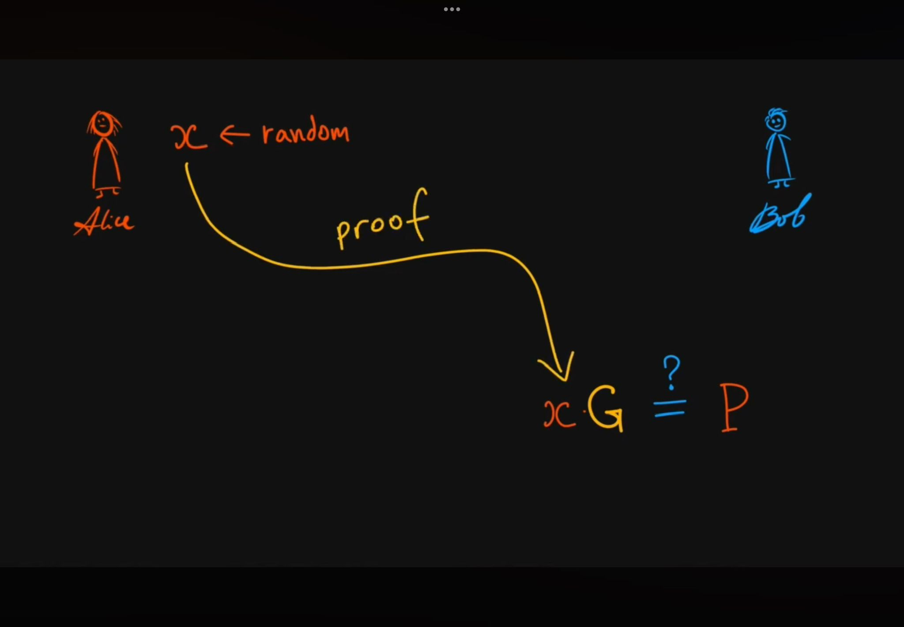

Slide 20
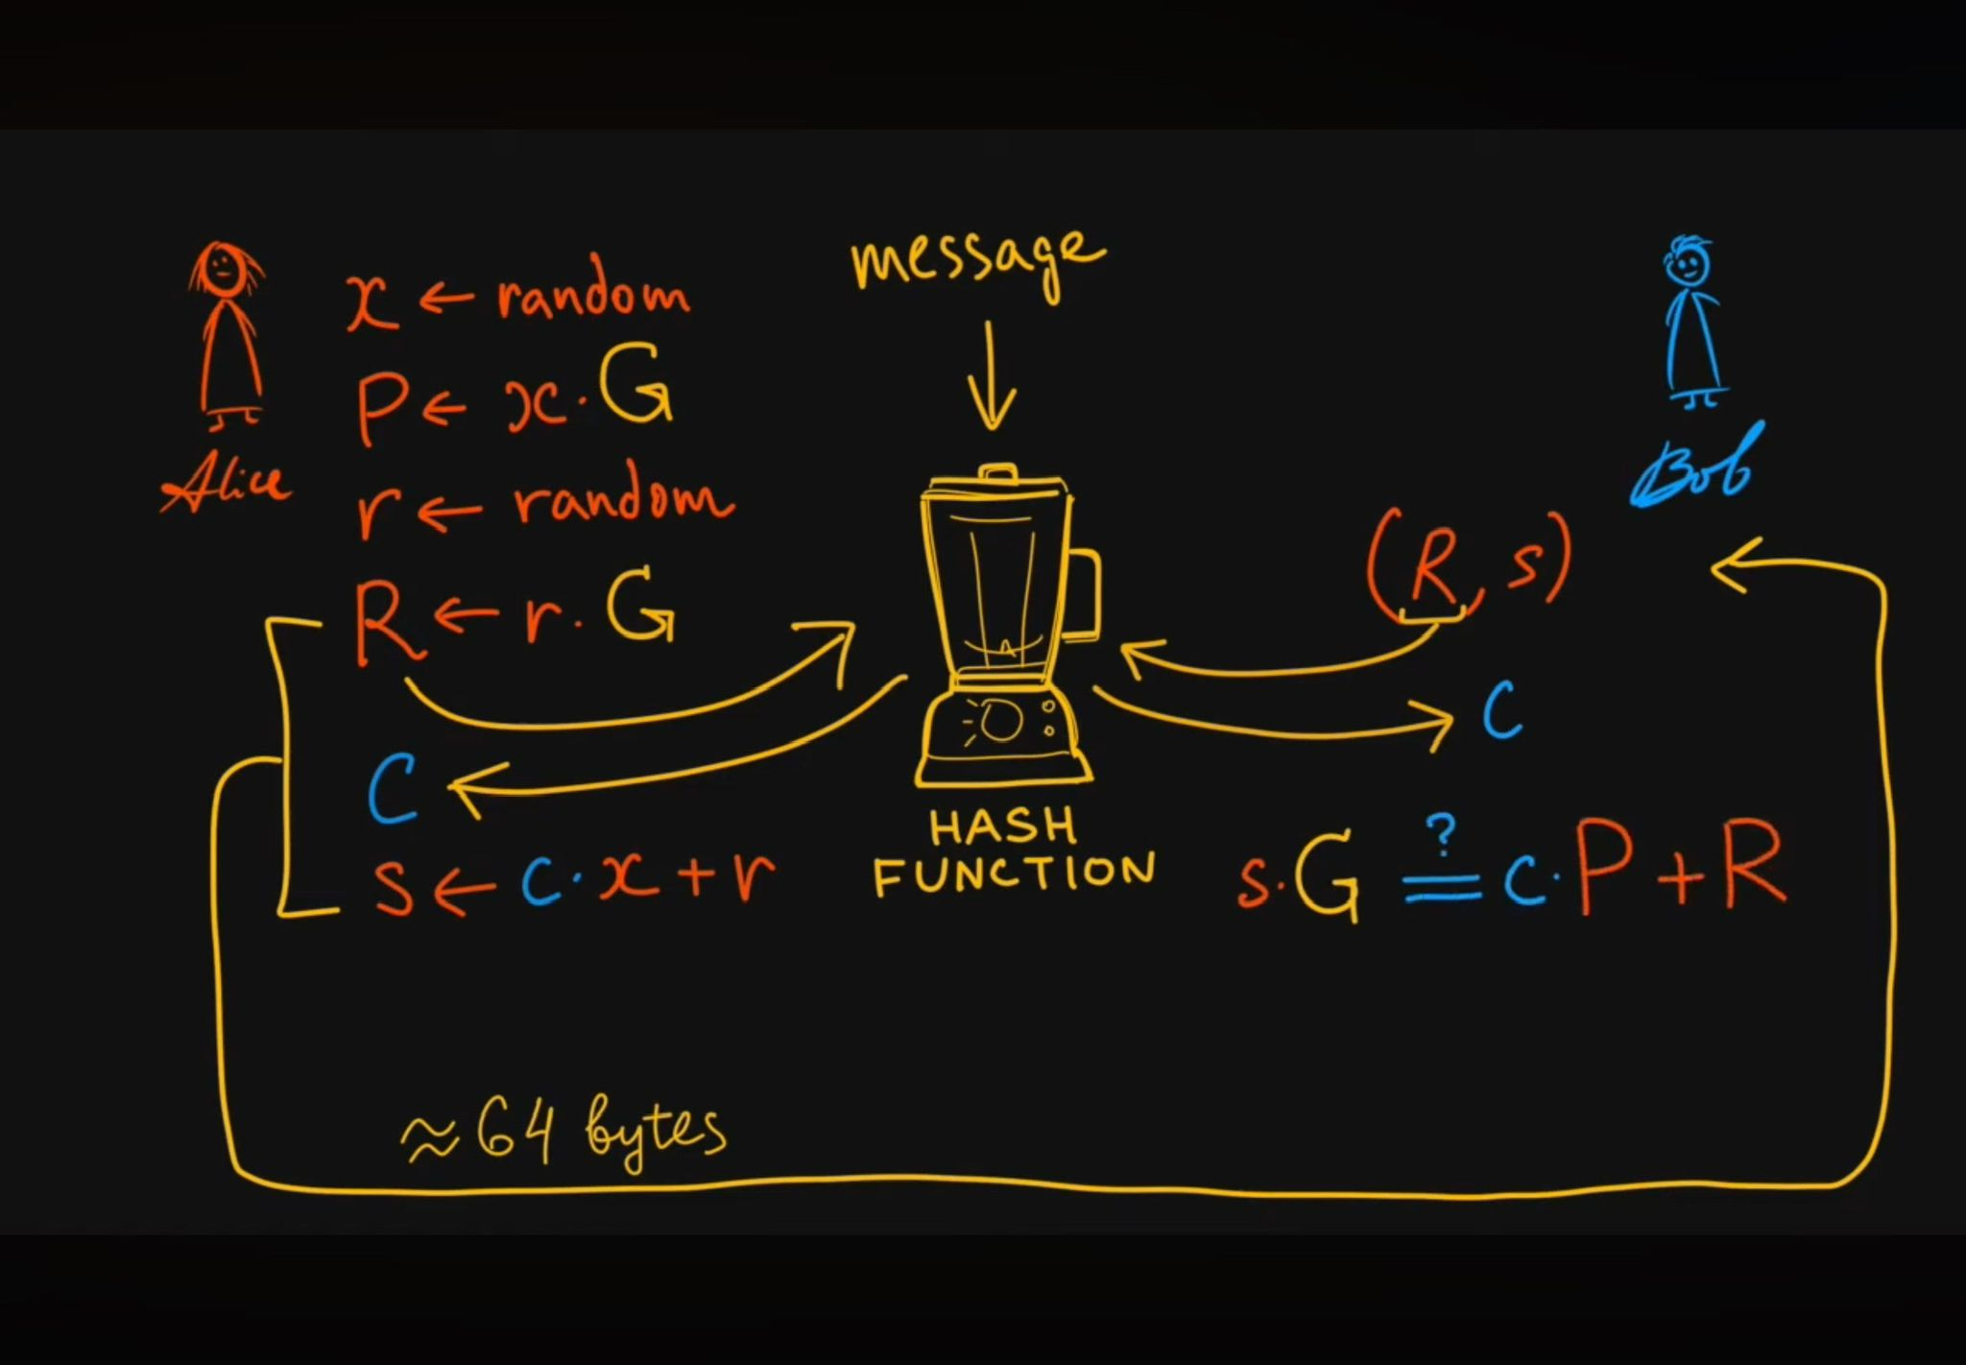
R = G^r mod N
c = H(R,P,M)
Verification

Slide 21

Benefits of Using Schnorr Signature
1
Efficiency
2
Security
3
Compactness
Schnorr signature offers a highly efficient signature generation. making it suitable for different environments.
It provides a strong cryptographic primitives, such as security against various attacks.
The signature size is relatively small, making it suitable for applications with limited bandwidth or storage capacity.

Slide 22
Comparison with Other Signature Algorithms
Schnorr Signature
ECDSA
RSA
Efficient, compact, and secure, offering a balance between speed and security, making it suitable for various applications.
Another popular signature algorithm, known for its strong security but can be computationally expensive.
Widely used, but its signature generation and verification processes can be slower compared to Schnorr, especially for larger messages.

Slide 23

Real-World Examples of Schnorr Signature Usage
1
Blockchain
2
Secure Communication
3
Digital Identity

Slide 24

Moving to the code..
Implementing all of the components into our code

Slide 25
Encrypting a sound file:
Sound Data Encryption using LEA in CFB mode
1
Key Generation
2
LEA Key Protection
3
- A random 16-byte (128-bit) LEA key is generated using os.urandom()
- A random 16-byte Initialization Vector (IV) is generated
- These ensure unique encryption each time
- The LEA key is encrypted using RSA
- Purpose: To securely share the LEA key with intended recipients
- Uses recipient's RSA public key
- Only someone with the private RSA key can decrypt it
- Takes the original sound file data,Breaks it into 16-byte blocks
a. Encrypts the previous block (First block with IV)
b. XORs result with current data block
c. Produces encrypted block
d. Moves to next block

Slide 26
Encrypting a sound file:
4
Digital Signature (using Schnorr)
5
Output Generation
- Creates two files:
a. .encrypted file: Contains the encrypted sound data
b. .meta file: Contains:
- IV (hex)
- Encrypted LEA key (hex)
- Signature values (r and s)
- Sender’s public keys (Schnorr and RSA)
- Creates a signature of the encrypted data
a. Takes the encrypted sound data
b. Generates signature using Schnorr private key
c. Produces two numbers (r,s) as the signature

Slide 27

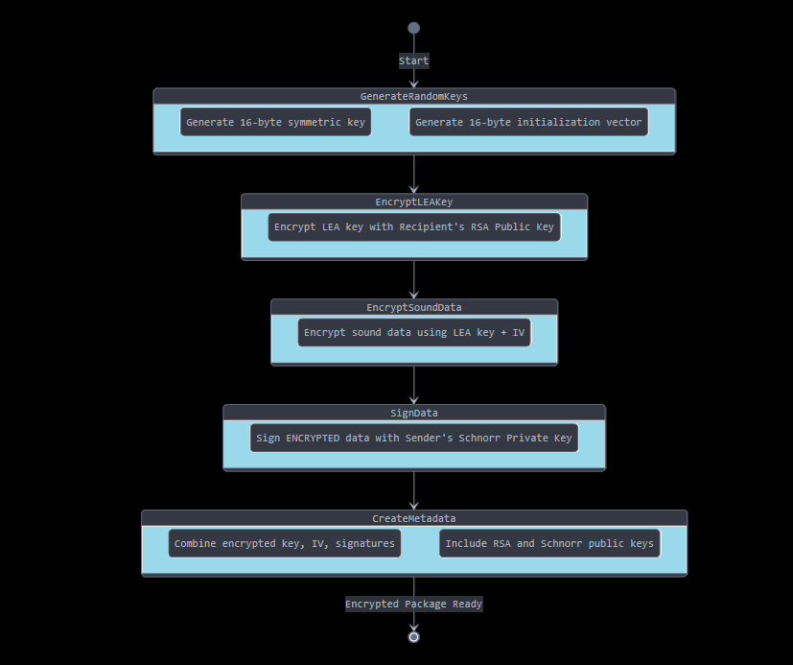
Encryption flow diagram:

Slide 28

Decrypting a sound file:
1
Input Reading
2
Signature Verification
3
LEA Key Recovery
- Reads the encrypted sound file
- Reads the meta file containing:
a. IV
b. Encrypted LEA key
c. Signature values
d. Schnorr and RSA keys
- Uses Schnorr signature verification
a. Takes encrypted data and signature (r,s)
b. Verifies using Schnorr public key (sender public key)
c. If verification fails, process stops
- Decrypts the encrypted LEA key using RSA
a. Uses private RSA key
b. Decrypts to recover original LEA key
c. This key will be used to decrypt the sound data

Slide 29
Decrypting a sound file:
4
Sound Data Decryption
5
Output Generation
- Removes any padding added during encryption
- Writes decrypted data to new sound file
- This file should be the same as the original file (before encrypting)
- Uses recovered LEA key and stored IV, for each block:
a. Decrypts previous ciphertext (or IV for first block)
b. XORs with current encrypted block
c. Produces original data block
d. Moves to next block

Slide 30

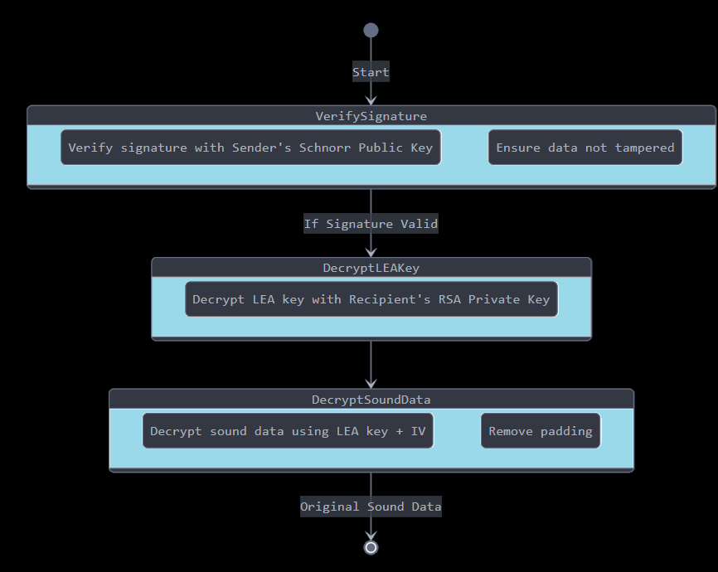
Decryption flow diagram:

Slide 31

Thanks for listening!

